Slide 1

Advanced Cryptography: ICT-6115
Introduction to Cryptography
Most. Jebun Nahar Juthy ( IT23612 )
Dept. of ICT, MBSTU, Tangail-1902
30 Nov 2024, MBSTU, Tangail

Slide 2
OUTLINE
What is Cryptography?
Key Concepts in Cryptography
Private Key Cryptography
Public Key Cryptography

Slide 3



Cryptography
Confidentiality
Integrity
Availability

Slide 4
Key Concepts in Cryptography
Plaintext
Ciphertext
Encryption
Decryption

Slide 5
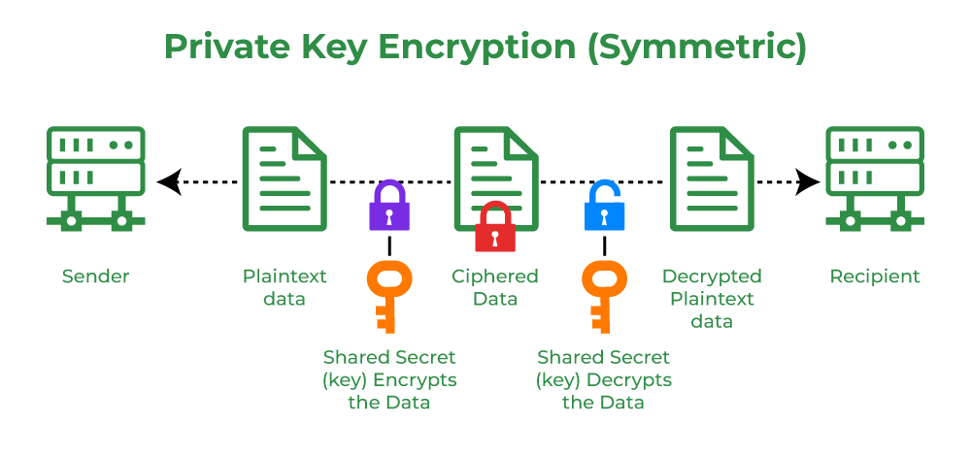
Types of Cryptography
Private key Cryptography

Slide 6

Private key Cryptography
Example 7.1
One of the first and most famous private key cryptosystems
was the shift code used by Julius Caesar.
We first digitize the alphabet
by letting A = 00, B = 01, . . . , Z = 25.
The encoding function will be,
$f\left(p\right)=$ $p+3 mod 26$
that is, A → D, B → E, . . . , Z → C.
The decoding function is then,
$f^{−1}\left(p\right)=p−3 mod 26$
$=$ $p+23 mod 26$

Slide 7
Private key Cryptography
Example 7.1 continued..
Suppose we receive the encoded message CRYPTO.
To decode this message, we first digitize it:
2, 17,24,15,19,14.
Next, we apply the inverse transformation:
25, 14, 21, 12, 16,11.
and get ZOUMQL

Slide 8
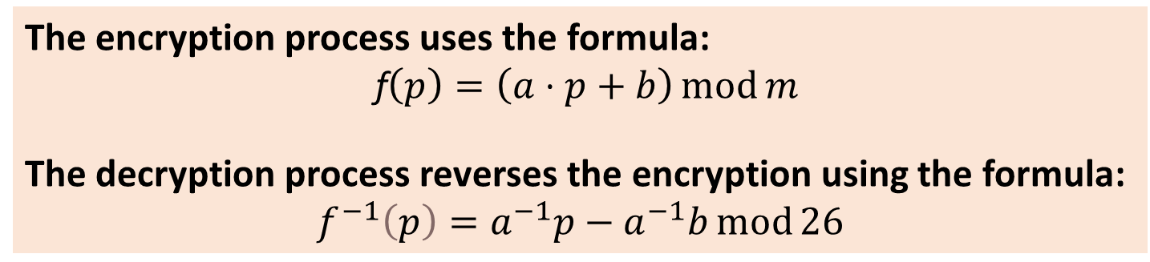
Private key Cryptography
Affine Cryptosystem
A type of substitution cipher in cryptography that combines two mathematical operations: multiplication and addition, to encrypt and decrypt messages.
It uses modular arithmetic to ensure the transformations stay within the alphabet range.
The encryption process uses the formula:
f$\left(p\right)=\left(a⋅p+b\right)\operatorname{mod}{m}$
The decryption process reverses the encryption using the formula:
$$f^{−1}\left(p\right)=a^{−1}p−a^{−1}b\operatorname{mod}{26}$$

Slide 9
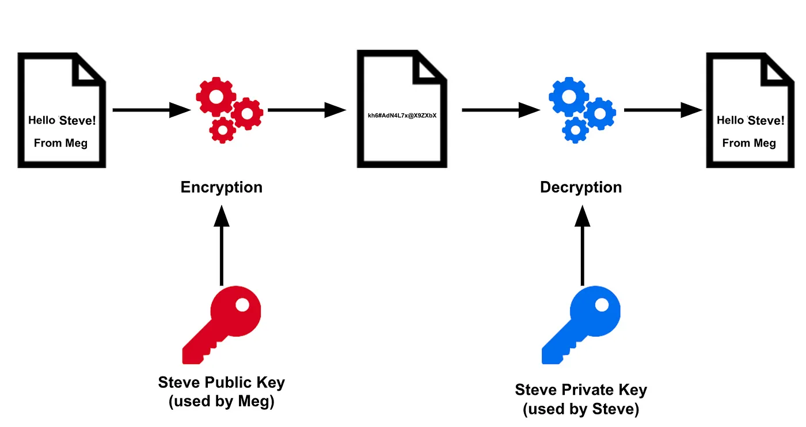
Types of Cryptography
Public key Cryptography

Slide 10
Public Key Cryptography: RSA
Developed by: R. Rivest, A. Shamir, and L. Adleman (1978).
Based on: RSA is an asymmetric encryption algorithm that uses a public key and a private key to encrypt and decrypt data.
RSA works by creating a public key that's the product of two large prime numbers, along with an auxiliary value. The prime factors are kept secret. Anyone can use the public key to encrypt a message, but only someone with the prime factors can decode it.

Slide 11

How RSA Works: Key Generation
1. Choose two large prime numbers p and q.
2. Compute :
$$→n=p×q$$
$$→φ\left(n\right)=\left(p−1\right)\left(q−1\right)\left(Euler^{′}s φ−function\right)$$
3. Find a number EEE (public key) such that:
$$\gcd\left(E,φ\left(n\right)\right)=1$$
4. Use the Euclidean Algorithm to find D (private key) such that:
$$D×E≡1\left(\operatorname{mod}{φ\left(n\right)}\right)$$

Slide 12
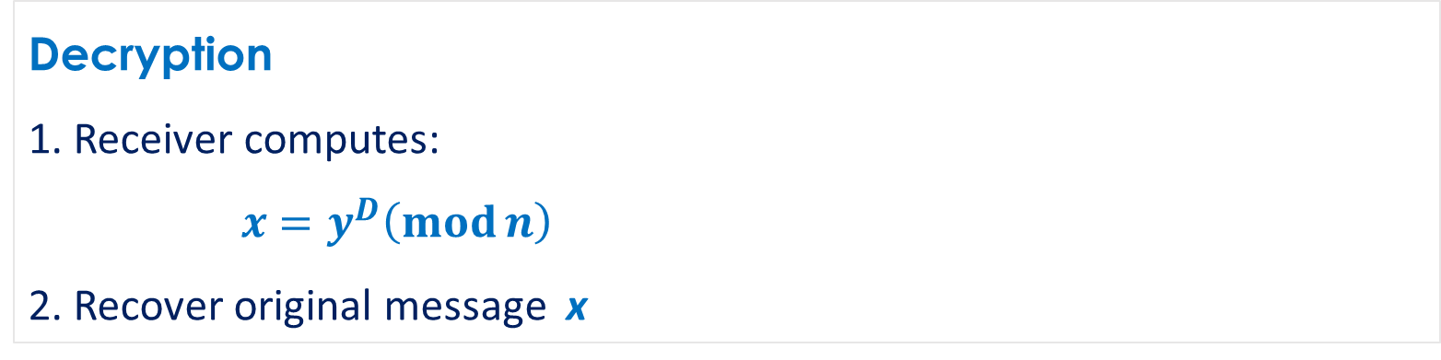
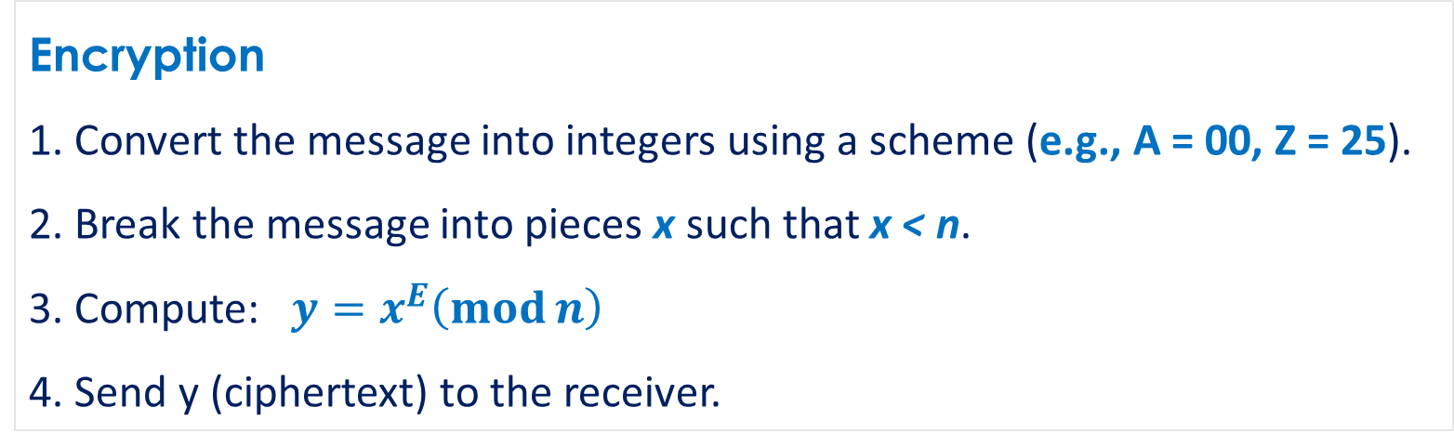
How RSA Works
Encryption
1. Convert the message into integers using a scheme (e.g., A = 00, Z = 25).
2. Break the message into pieces x such that x < n.
3. Compute: $y=x^{E}\left(\operatorname{mod}{n}\right)$
4. Send y (ciphertext) to the receiver.
Decryption
1. Receiver computes:
$$x=y^{D}\left(\operatorname{mod}{n}\right)$$
2. Recover original message x

Slide 13
Thank You

Slide 14

$$n=p×q$$
$$φ\left(n\right)=\left(p−1\right)\left(q−1\right)\left(Euler^{′}s φ−function\right)$$
$$\gcd\left(E,φ\left(n\right)\right)=1$$
$$D×E≡1\left(\operatorname{mod}{φ\left(n\right)}\right)$$
$$y=x^{E}\left(\operatorname{mod}{n}\right)$$
Cryptography

Slide 15
Example 7.1
One of the first and most famous private key cryptosystems
was the shift code used by Julius Caesar. We first digitize the alphabet
by letting A = 00, B = 01, . . . , Z = 25. The encoding function will be
f(p) = p + 3 mod 26;
that is, A 7→ D, B 7→ E, . . . , Z 7→ C. The decoding function is then
f−1(p) = p − 3 mod 26 = p + 23 mod 26.
Suppose we receive the encoded message DOJHEUD. To decode this message, we first digitize it:
3, 14, 9, 7, 4, 20, 3.
Next we apply the inverse transformation to get
0, 11, 6, 4, 1, 17, 0,
ALGEBRA
cryptanalysis (codebreaking) - study of principles/ methods of
deciphering ciphertext without knowing key
The Affine Cryptosystem is a type of substitution cipher in cryptography that
combines two mathematical operations, multiplication and addition, to
encrypt and decrypt messages. It uses modular arithmetic to ensure
the transformations stay within the alphabet range.
The encryption process uses the formula:
E(x)=(a⋅x+b)mod mE(x) = (a \cdot x + b) \mod mE(x)=(a⋅x+b)mod m
Affine Cipher Decryption
The decryption process reverses the encryption using the formula:
D(y)=a−1⋅(y−b)mod mD(y) = a^{-1} \cdot (y - b) \mod mD(y)=a−1⋅(y−b)modm

Slide 16
Cryptography is the study of sending and receiving secret messages. The aim of cryptography is to send messages across a channel so that only the intended recipient of the message can read it. In addition, when a message is received, the recipient usually requires some assurance that the message is authentic; that is, that it has not been sent by someone who is trying to deceive the recipient. Modern cryptography is heavily dependent on abstract algebra and number theory.
The message to be sent is called the plaintext message. The disguised message is called the ciphertext.

